Slide 1
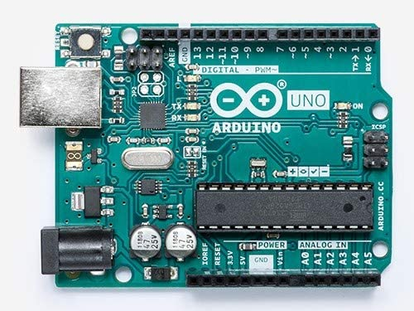



I T Project Anti-Theft System
Lancylord D’Monte 8661
Ritika Fargose 8665
Lance Main 8681

Slide 2

What is Internet Of Things ?
The Internet of Things is a network of physical objects – vehicles, machines, home appliances, and more – that use sensors and APIs to connect and exchange data over the Internet.
IOT is a giant network of devices that collect data via embedded censors about their way of use, requirement and working environment.
IOT provides a platform for storing this data, which is later used for better usage, automation and improving efficiency.
The quality and scope of the data across the Internet of Things generates an opportunity for much more contextualised and responsive interactions with devices to create a potential for change

Slide 3

Problem Statement.
To design an Anti-Theft System that focuses primarily on room security and doesn’t take into account the entire home security. A provision to alert the authorized person with an SMS when there is a breach in the security, along with the respective security agency.
Whenever an infiltrator spotted by the PIR sensor the door to be closed by the motor and the person to be trapped inside, since the door can be opened from outside only

Slide 4
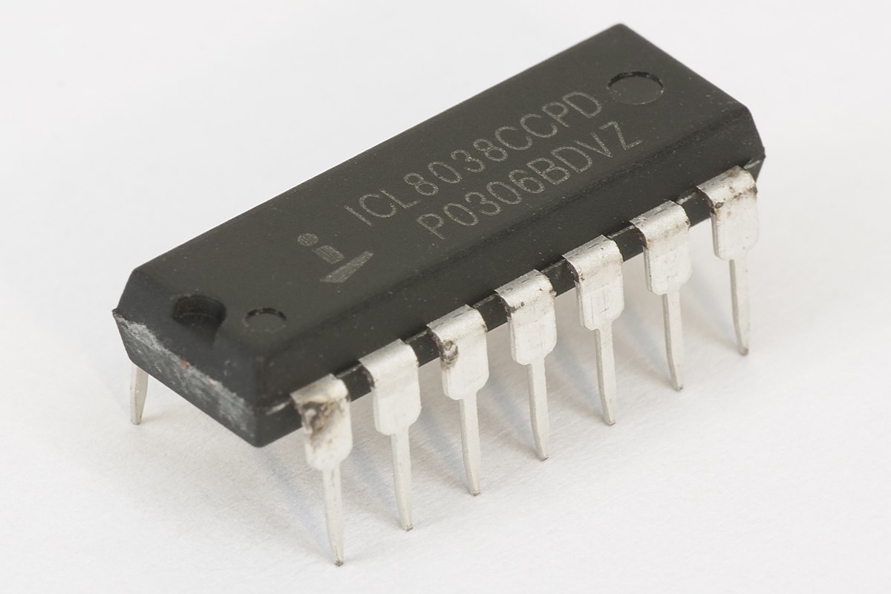
Need for this project
An essential system for homes, since there’s a hike in thefts now a days.
Very cost effective and easy to install.
Doesn’t require any modifications in the house, the system just fits in.
Prompts the user as well as the local police station, when there’s a breach.
A red bulb glows outside the room that is breached.

Slide 5
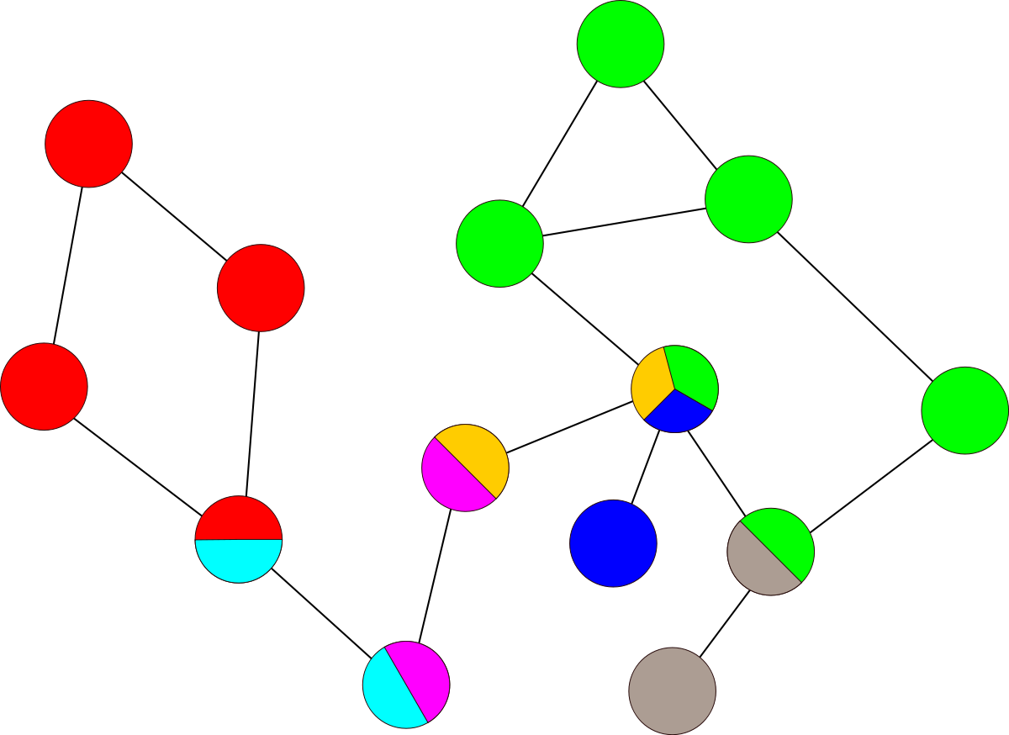
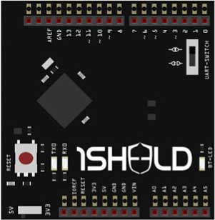
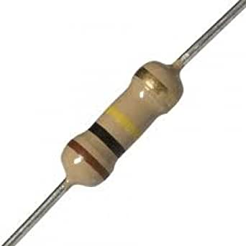
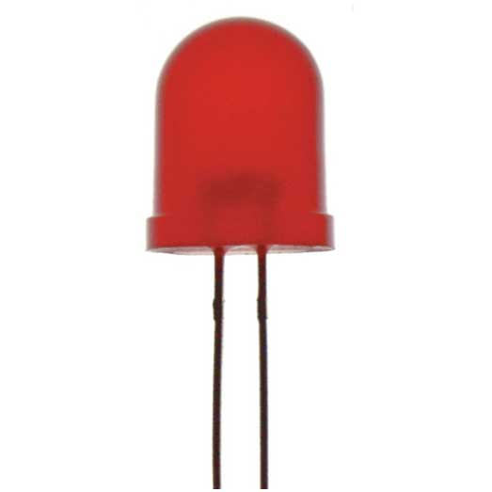
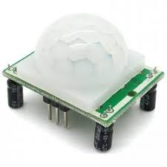
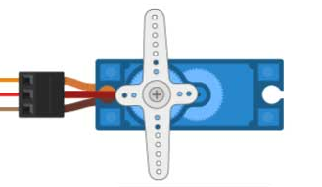
Components
HARDWARE
Arduino
1SHEELD
Resistor
LED
PIR Sensor
Servo motor
SOFTWARE
1SHEELD Application

Slide 6
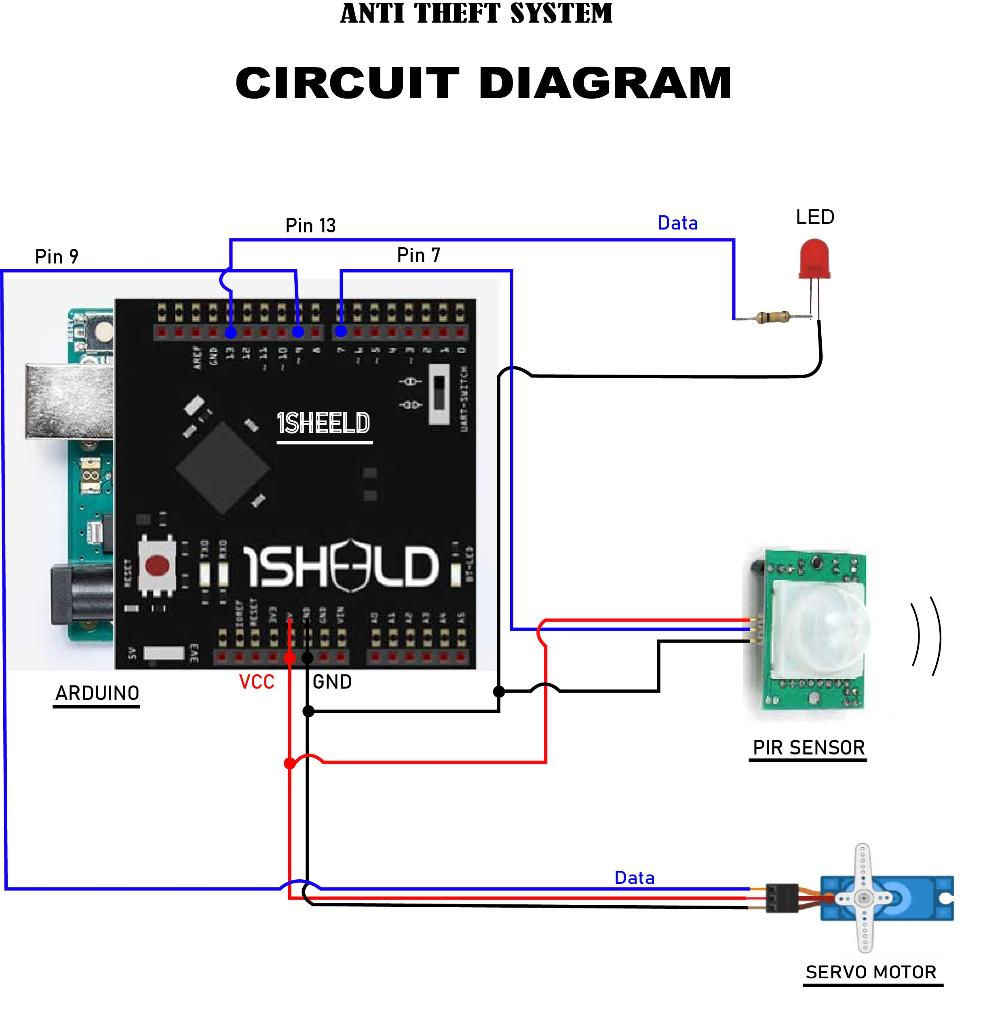

Slide 7
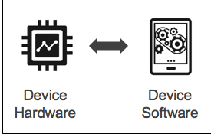
WORKING
Firstly, We have to power-on the Arduino System before leaving our residence.
Whenever Thief invades the room where PIR sensor is
connected, motion will be detected and sensor will
convert into digital signal and send input into Pin 7
connected on 1sheeld.
After receiving the signal Control statement will be
executed and Arduino will produce digital output
from Pin 13. The signal will be set to “high” and the Led
will glow.

Slide 8
WORKING
SMS
3. At same time to rotate the servo motor a command from
Arduino will be executed which will close the door.
By doing so, thief will be temporarily locked inside the
closed room.
4. Simultaneously, SMS will be sent to the mobile number
which will be done by 1sheeld. 1Sheeld will be connected
to mobile software “1Sheeld”. Owner of the house will
instantly get notified and can take proper actions in time.

Slide 9

CODE
#include<OneSheeld.h>
#include<Servo.h>
Servo myservo;
boolean isMessageSent = false;
const int sensorPin=7;
const int ledPin=13;
int sensorState=0;
void setup(){
OneSheeld.begin();
pinMode(ledPin,OUTPUT);
pinMode(sensorPin,INPUT)
myservo.attach (9);
}

Slide 10
Continue…
void loop(){
sensorState=digitalRead(sensorPin);
if (sensorState==HIGH)
{
if(!isMessageSent)
SMS.send(“834965768",“There is a Thief in the house");
digitalWrite(ledPin, HIGH);
myservo.write(90);
}
else{
isMessageSent = false;
digitalWrite(ledPin, LOW);
}
}

Slide 11
THANK YOU

